Slide 1
Photomicrographs of Plant foods
Olive
Permission to reproduce original photomicrographs used to make this collection may be obtained from
Dr. David O. Norris at
david.norris@colorado.edu

Slide 2
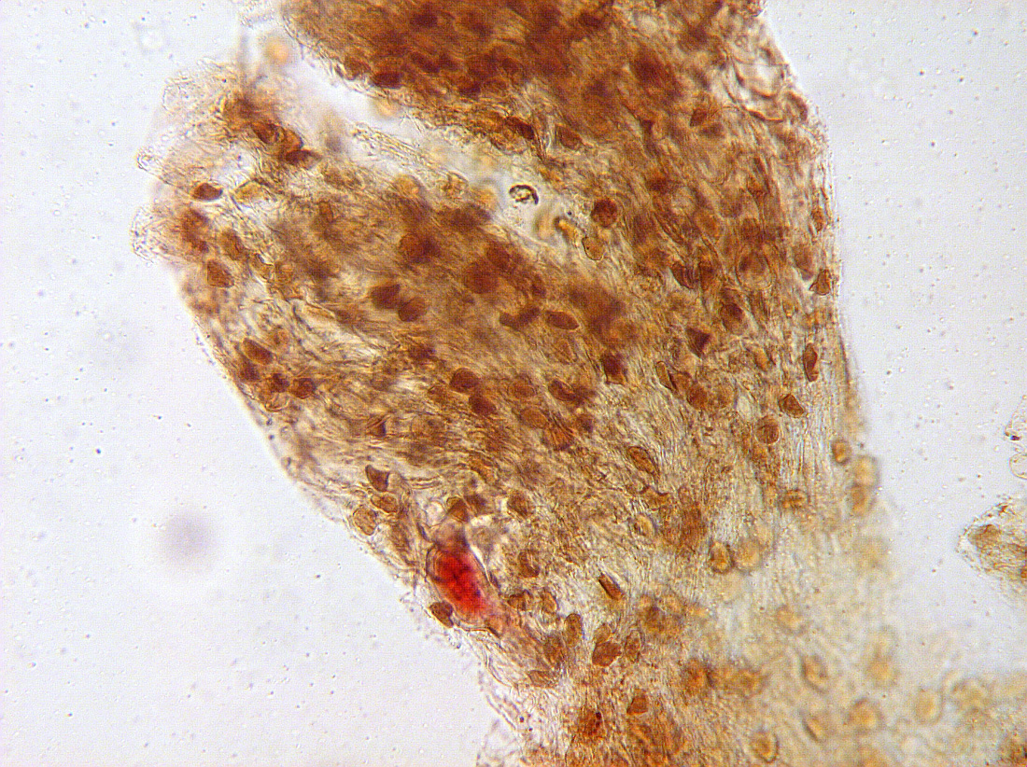
Notes:
302. Olea europaea L. Olive, black. Pulp, 10X.

Slide 3
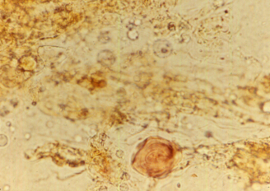
Notes:
303. Olive; pulp showing oil droplets (black arrows) and a sclerid (white arrow)

Slide 4
NEED NEW PICTURE
Notes:
304. Olive

Slide 5
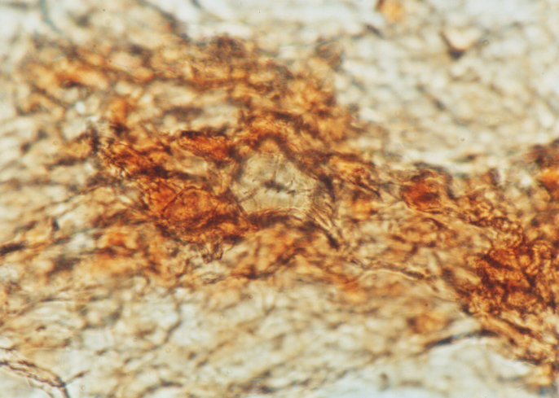
Notes:
305. Olive; sclerid in pulp stained with safranin, 40X

Slide 6
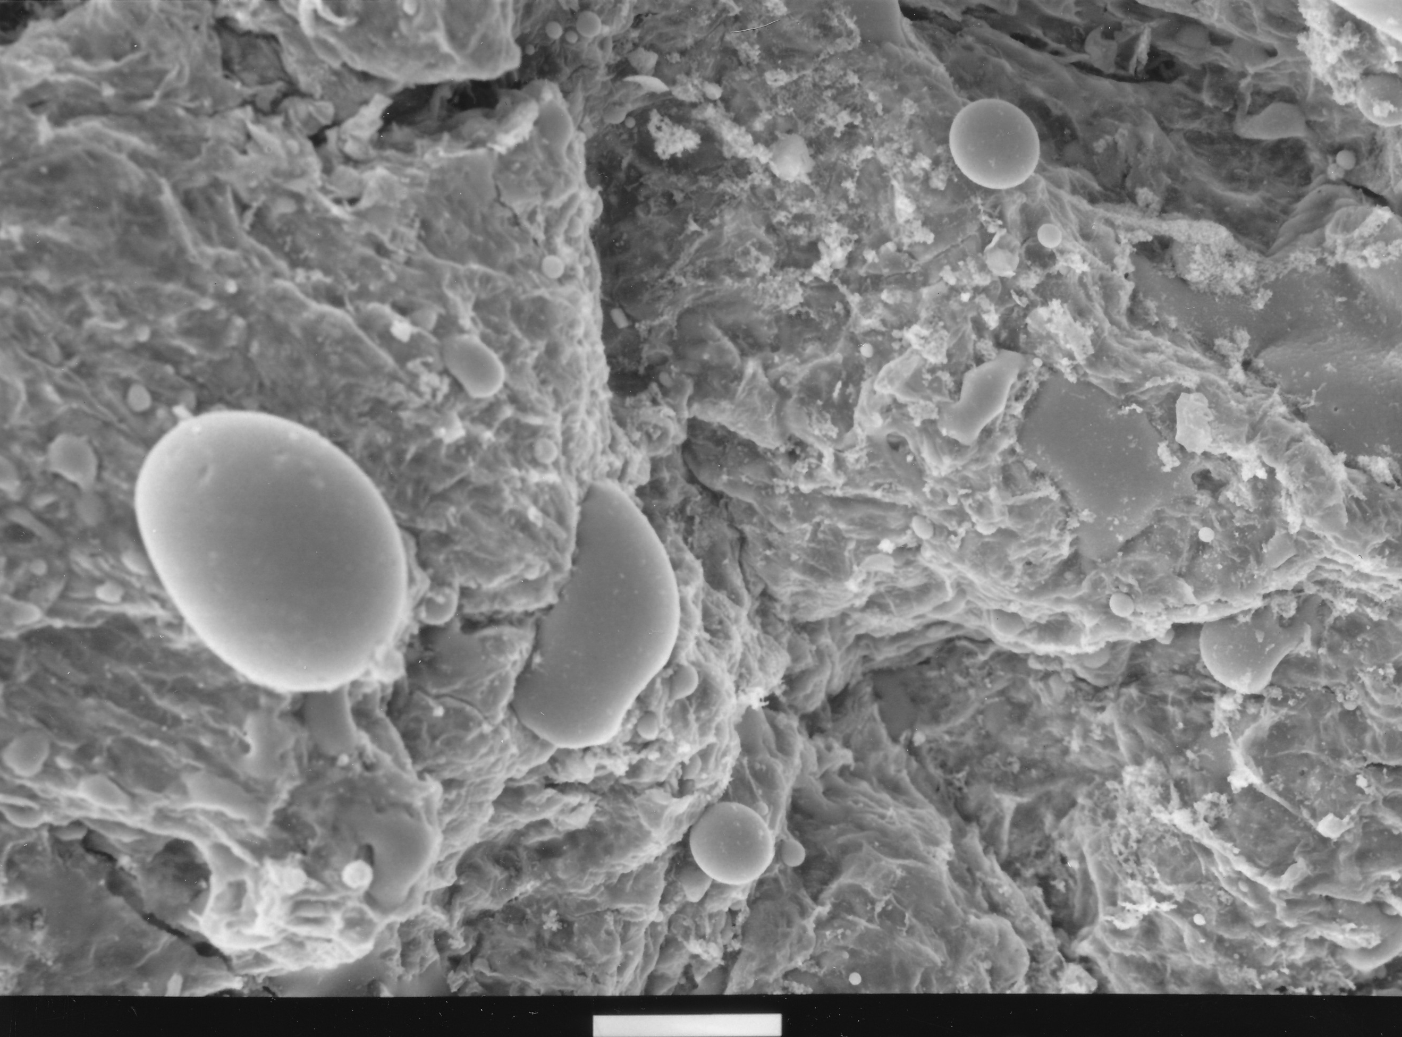
O
O
100 µm
Notes:
315. Olive. SEM showing oil droplets (O). Courtesy of Dr. Meredith A. Lane.

Slide 7
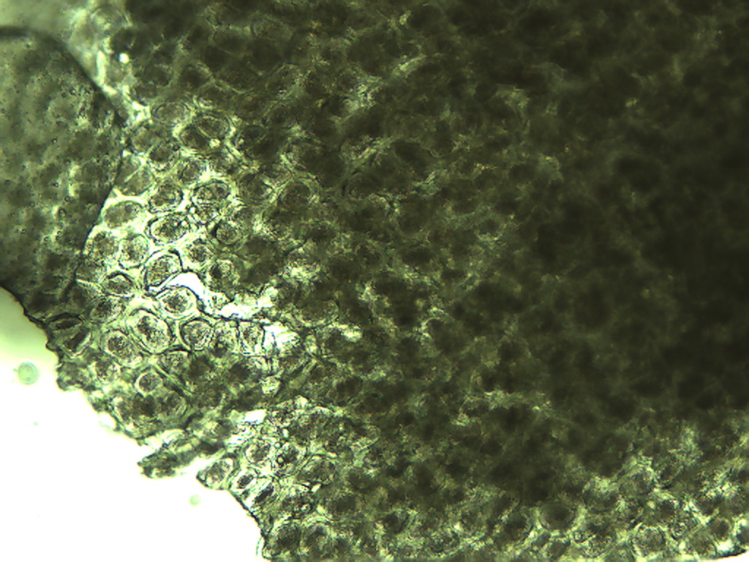
Notes:
306. Olea europaea L. Olive, green. Seed coat (testa), 10X

Slide 8
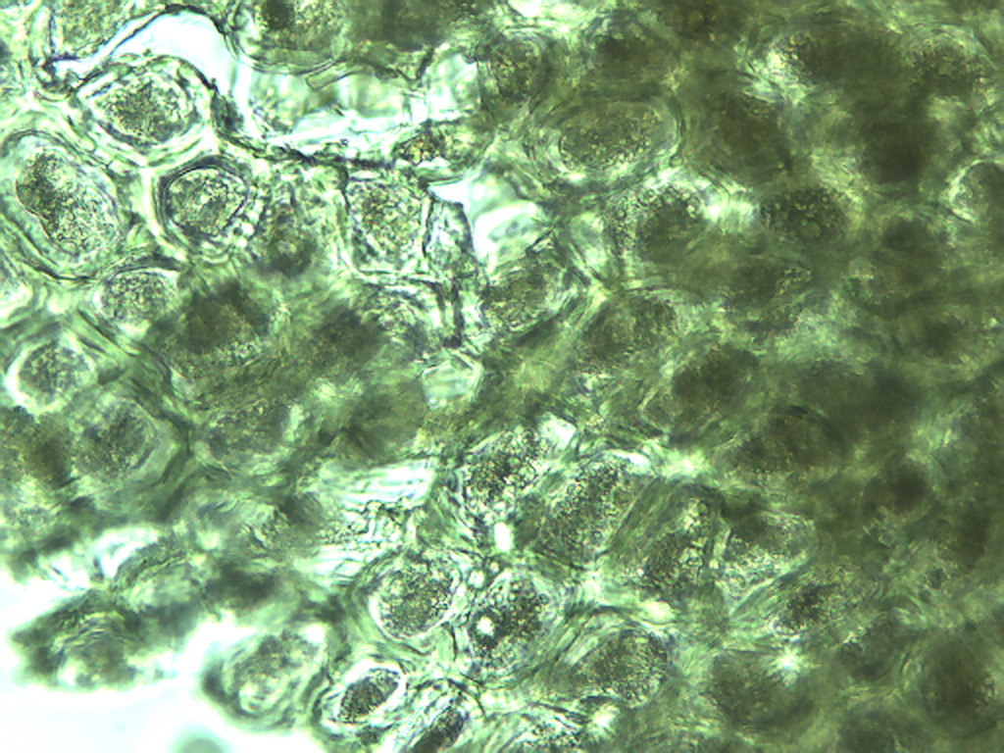
Notes:
307. Olive, green. Seed coat (testa), 25X

Slide 9
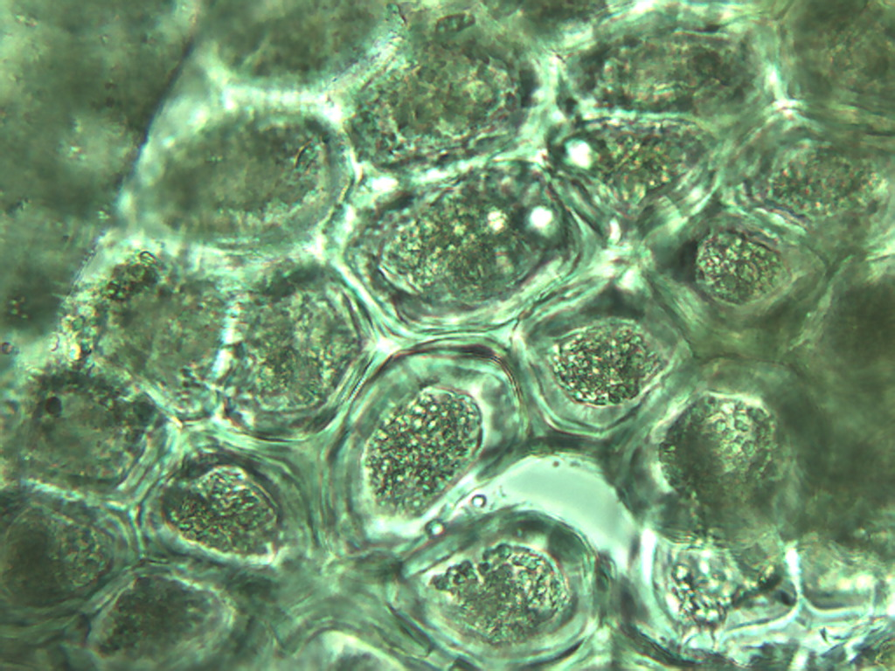
Notes:
308. Olive, green. Seed coat (testa), 40X

Slide 10
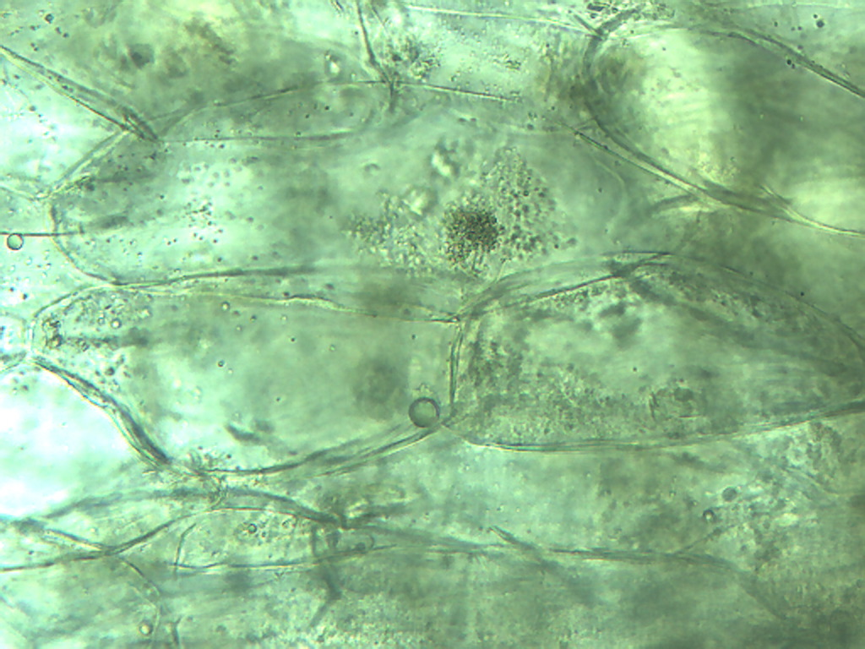
Notes:
309. Olive, green. Large parenchymal cells, 25X

Slide 11
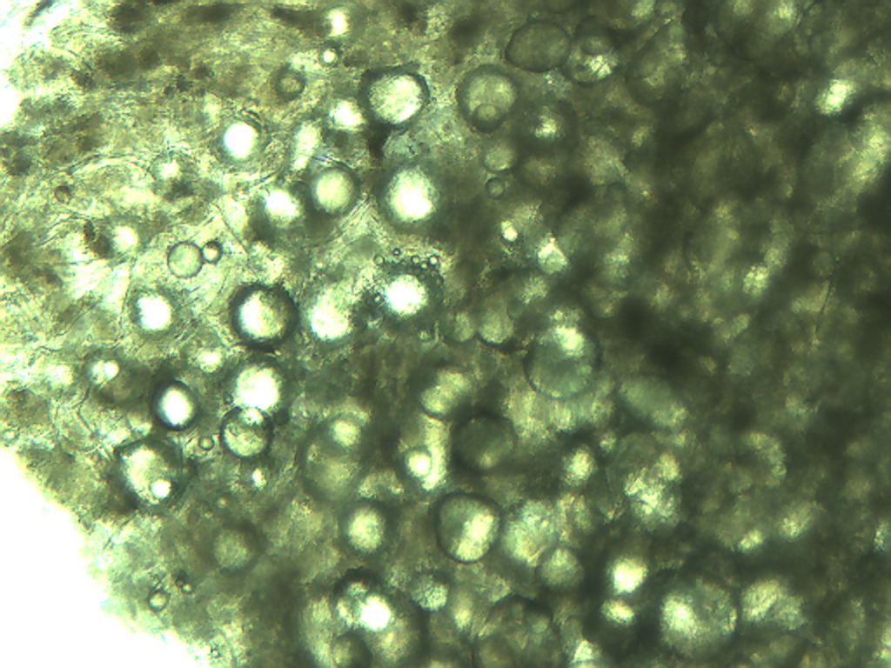
Notes:
310. Olive, green. Parenchymal cells and oil droplets in fresh olive, 10X

Slide 12
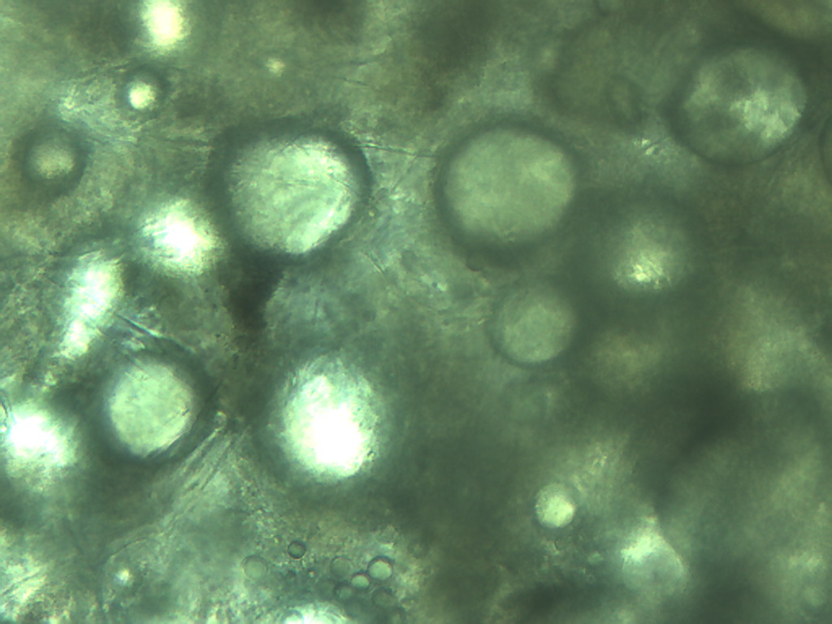
Notes:
311. Olive, green. Oil droplets in fresh olive, 25X

Slide 13
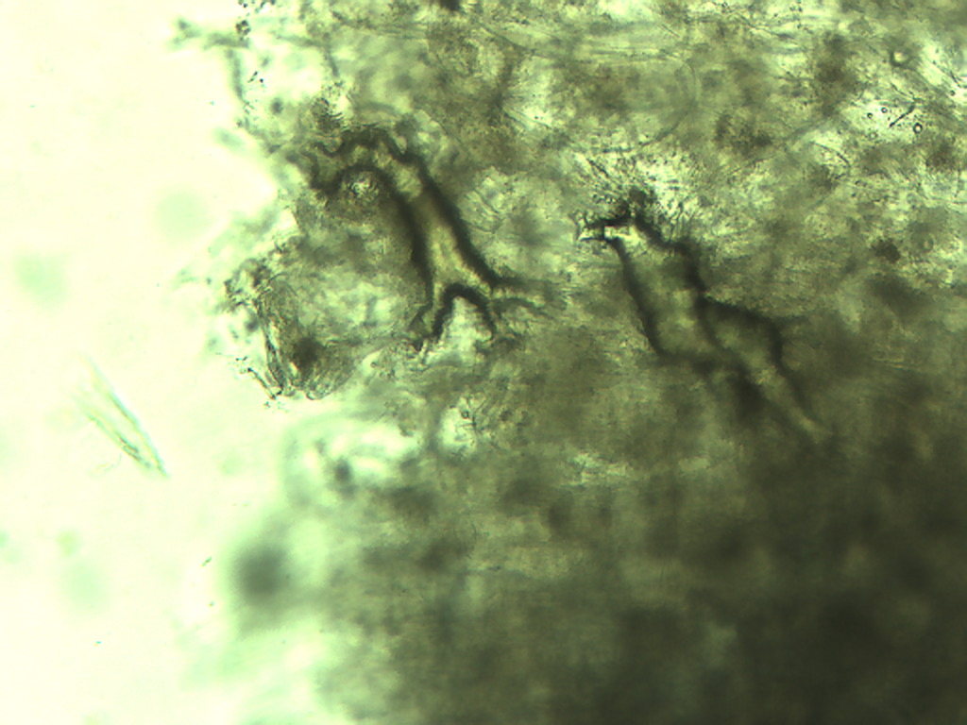
Notes:
312. Olive, green. Amorphous crystals (arrows), 10X.

Slide 14
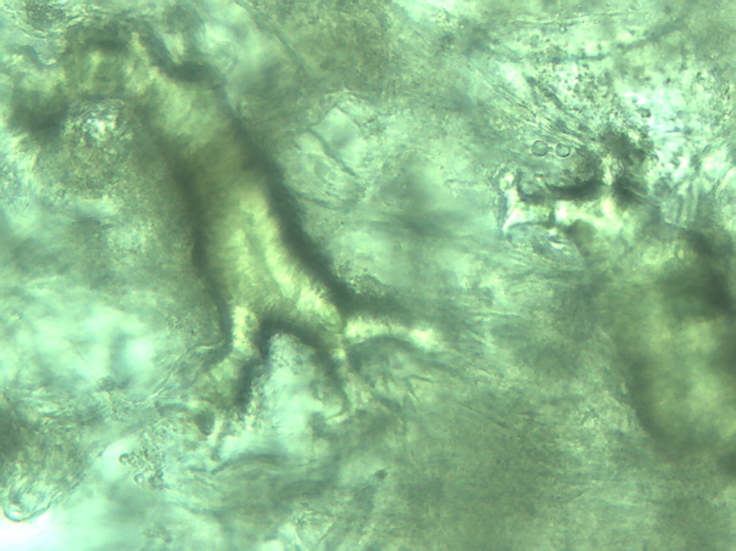
Notes:
313. Olive, green. Amorphous crystals (arrows), 25X

Slide 15
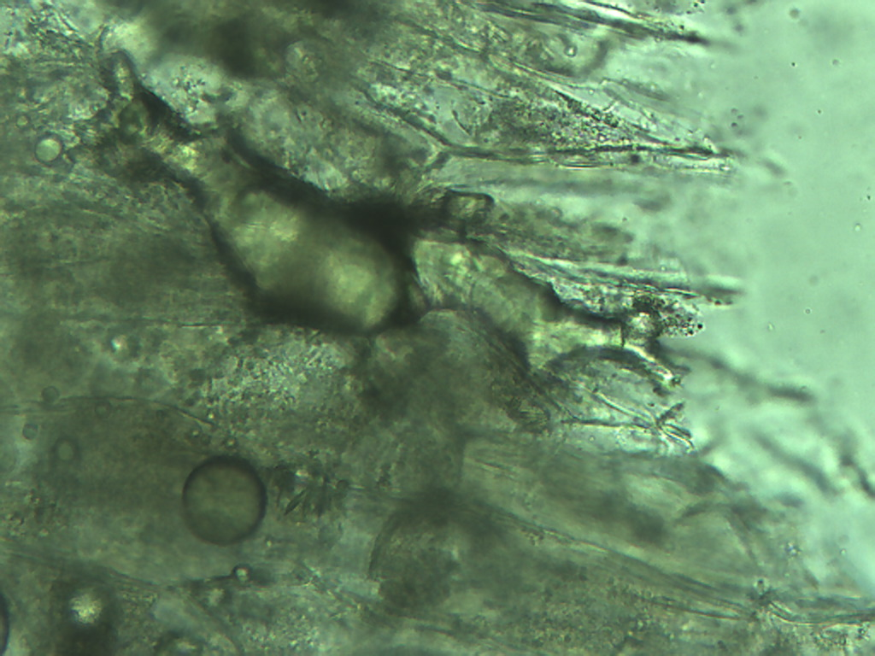
Notes:
314. Olive, green; amorphous crystal (arrow), 25X

